Slide 1
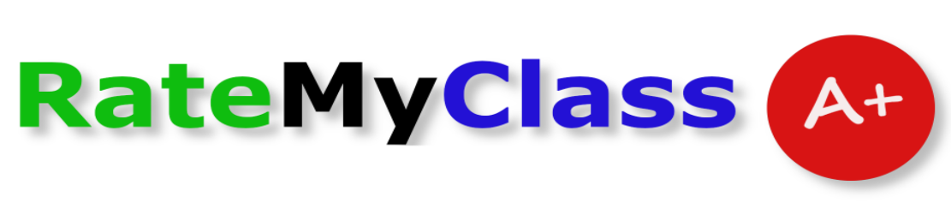
RateMyClass Application
Team 4
Tony Yang, Jason Bernal, and Jacob Smith

Slide 2


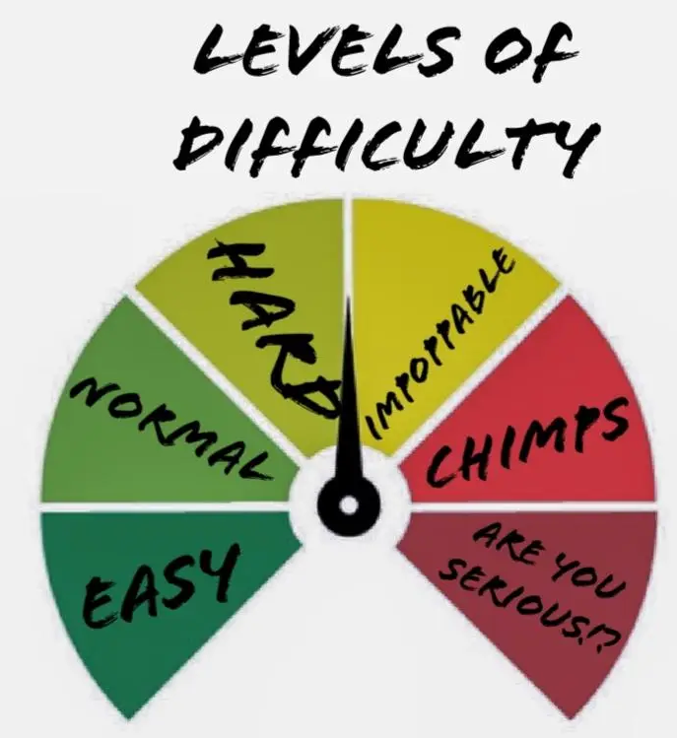
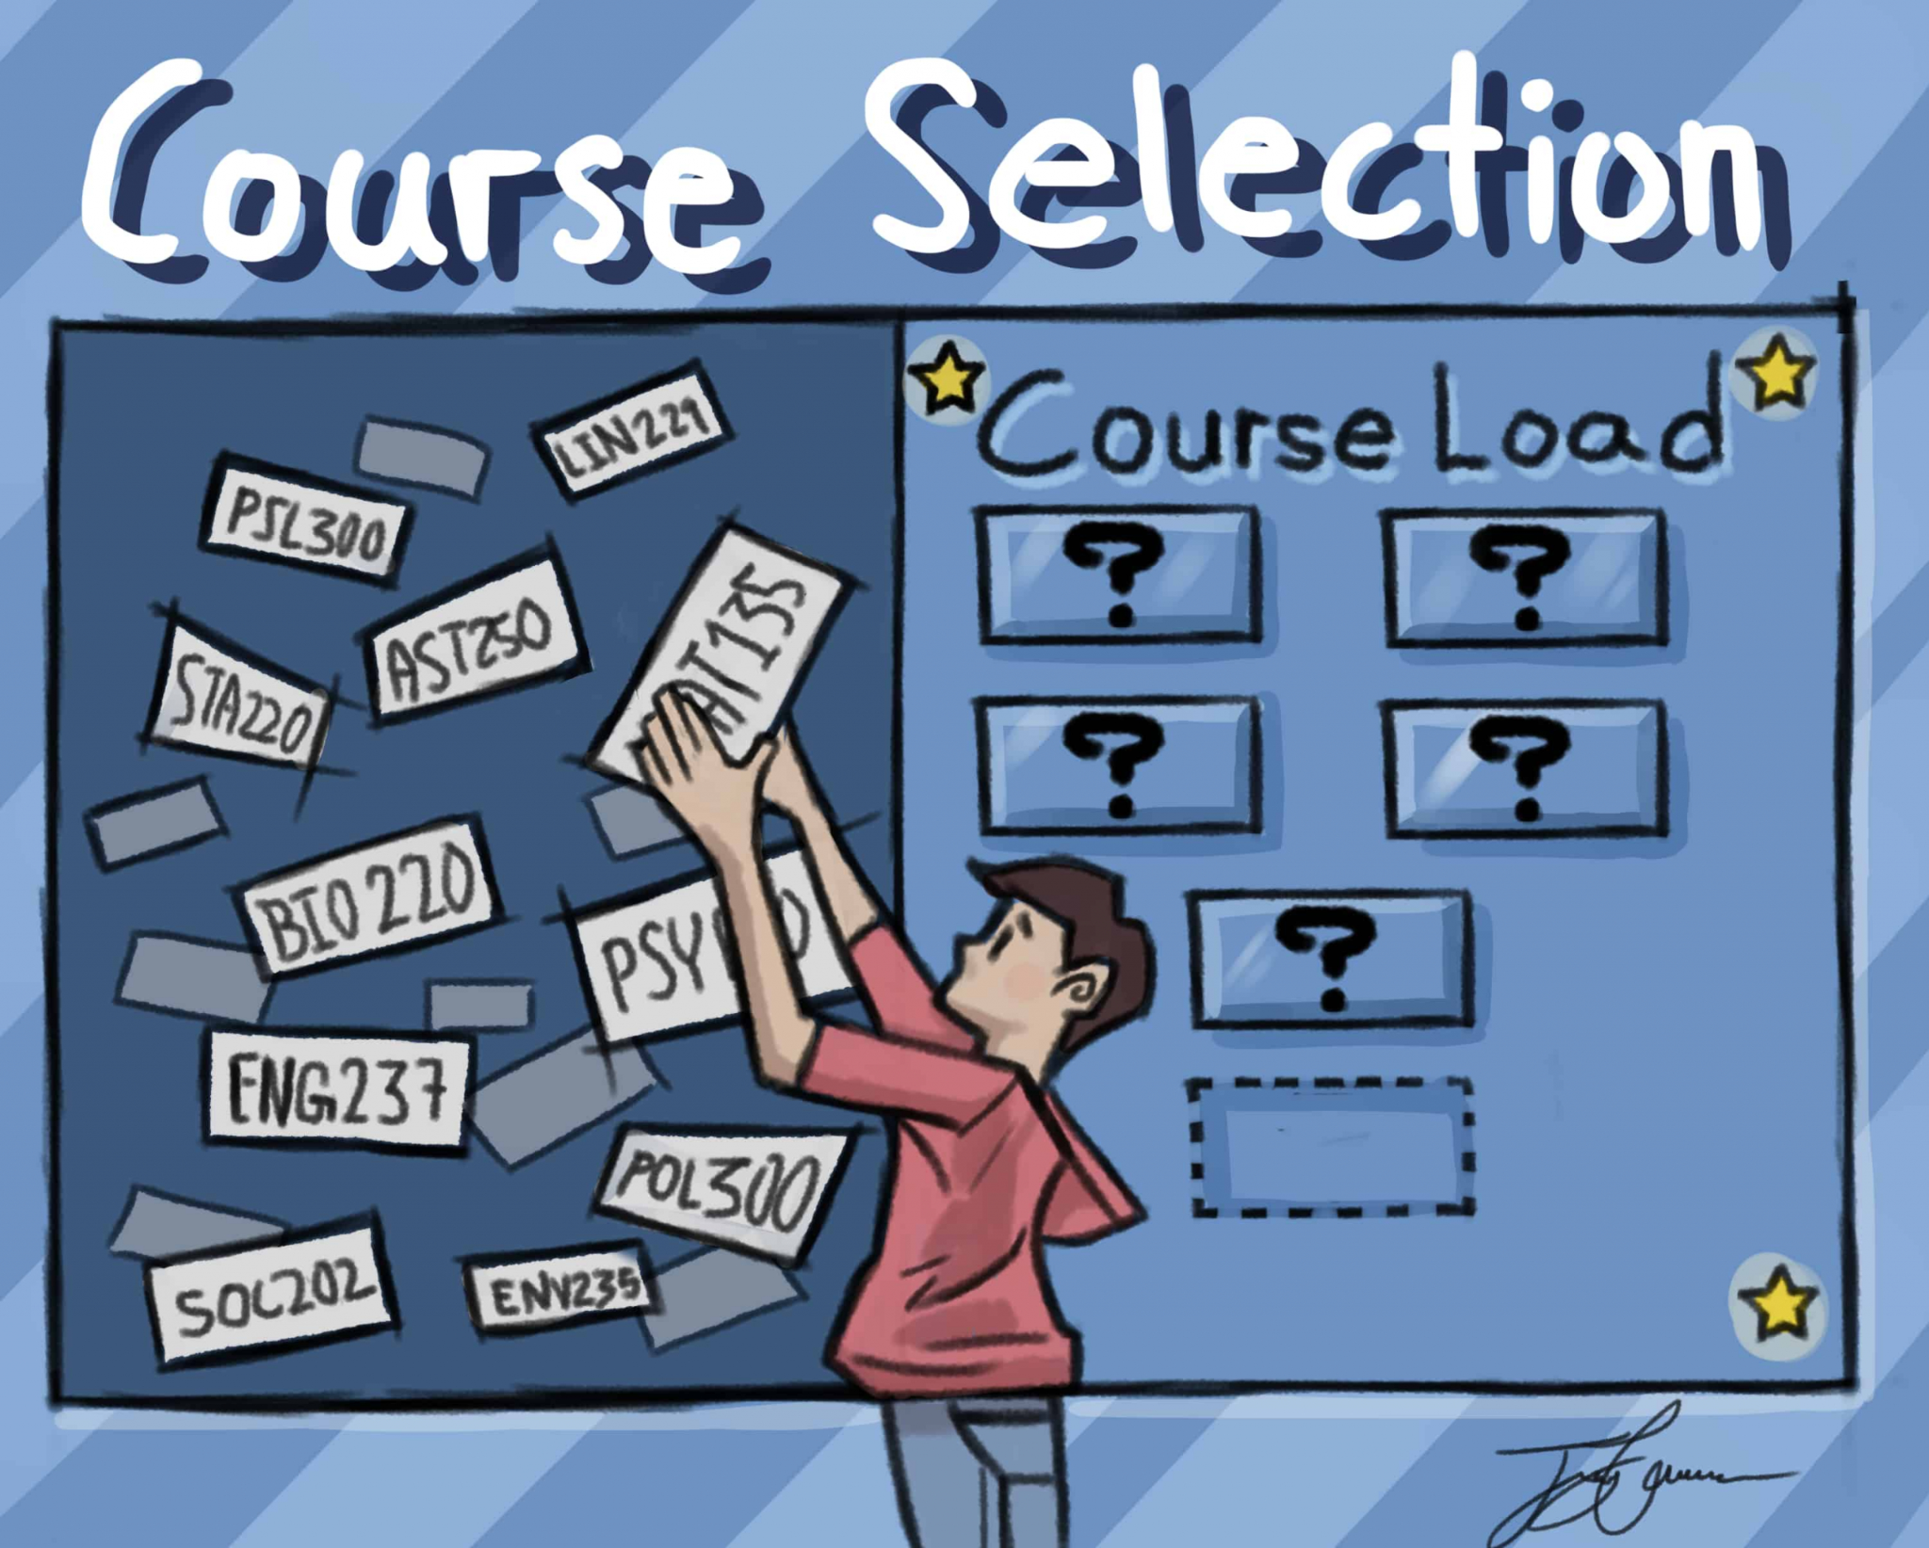
Purpose
Want to allow students to compare courses based on:
Difficulty
Time consumption
Doing Homework
Studying
Overall general comments

Slide 3

Purpose - Continued
Foster Discussion
Allow other students to comment on reviews
Allow professors to comment on reviews to provide their input

Slide 4


Purpose - Continued
Highlight/Pin Reviews
Professors can highlight/pin important reviews they deem important

Slide 5
Three Types of Users
Administrator
Can
Delete reviews, users, and comments
Can’t
Edit review or comment
Create reviews or comments
Student
Can
Create reviews and comments.
Flag reviews and comments
Edit and delete reviews and comments they made
Can’t
Delete or edit another student’s review or comment
Pin reviews
Professor
Can
Create comments.
Flag reviews and comments
Edit and delete comments they made
Pin reviews
Can’t
Create, delete or edit reviews
All can read posts, comments, and change their own password

Slide 6
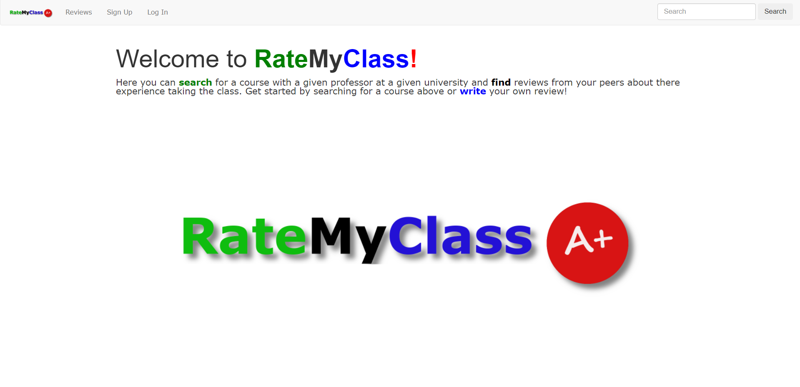
Homepage

Slide 7
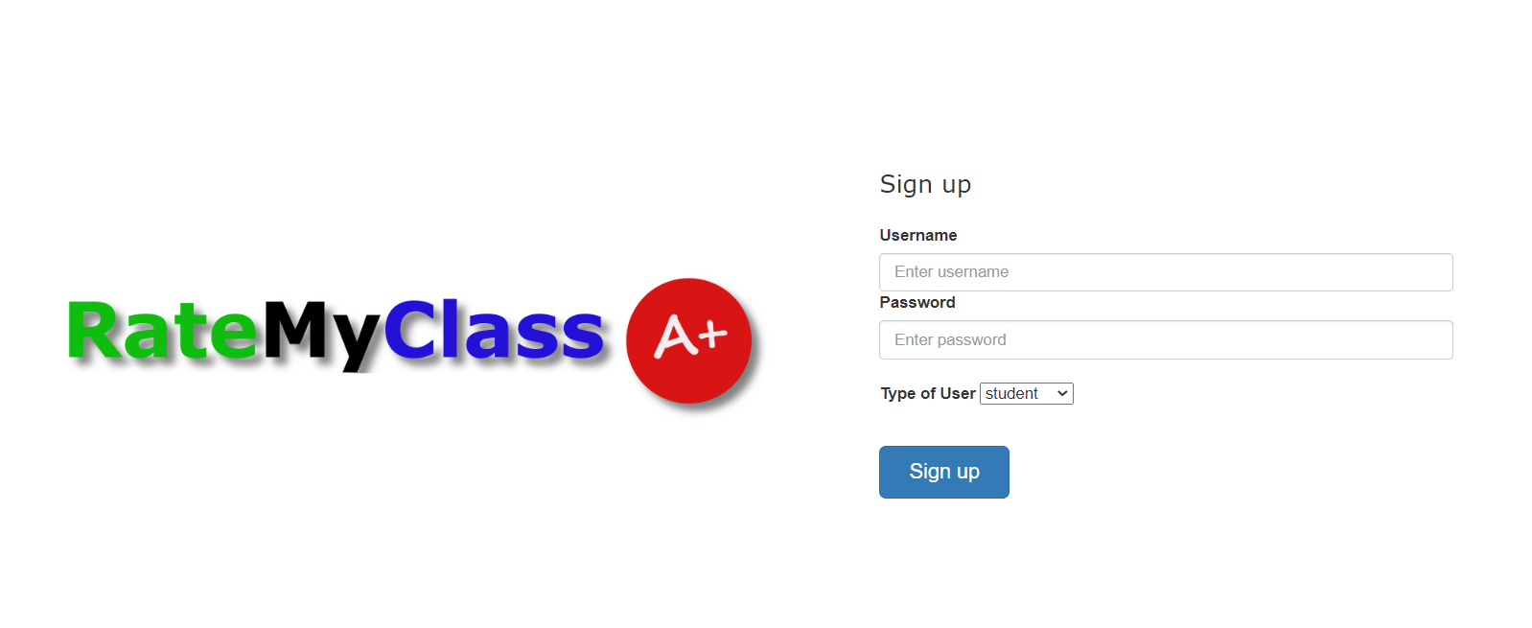
Sign Up Page

Slide 8
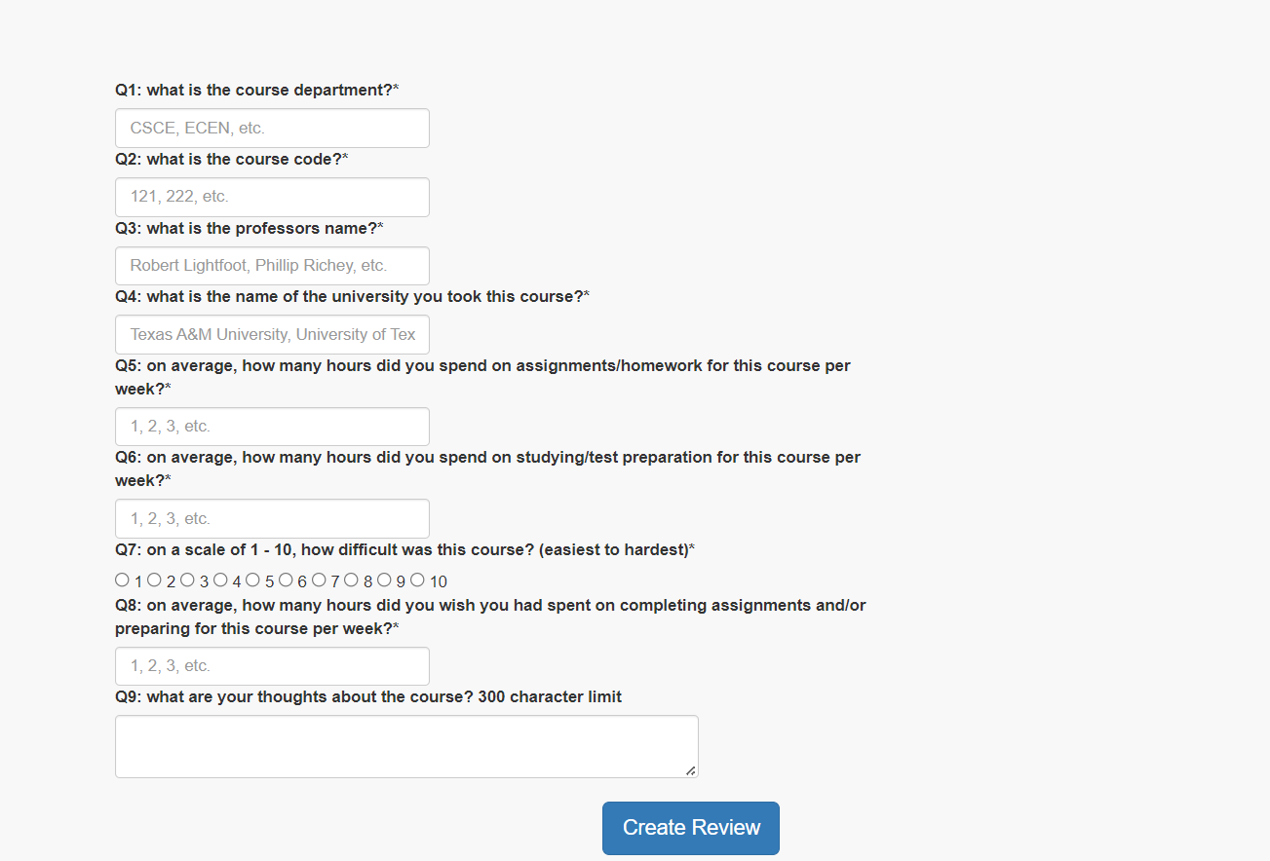
New Review

Slide 9
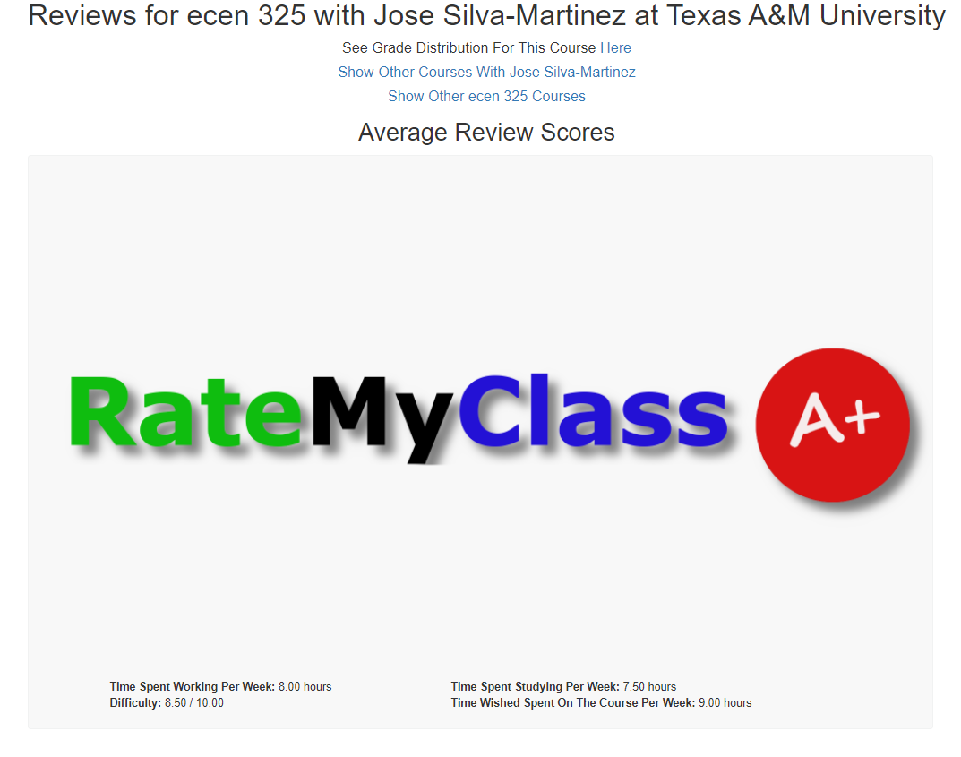
Header of Each Course Review

Slide 10
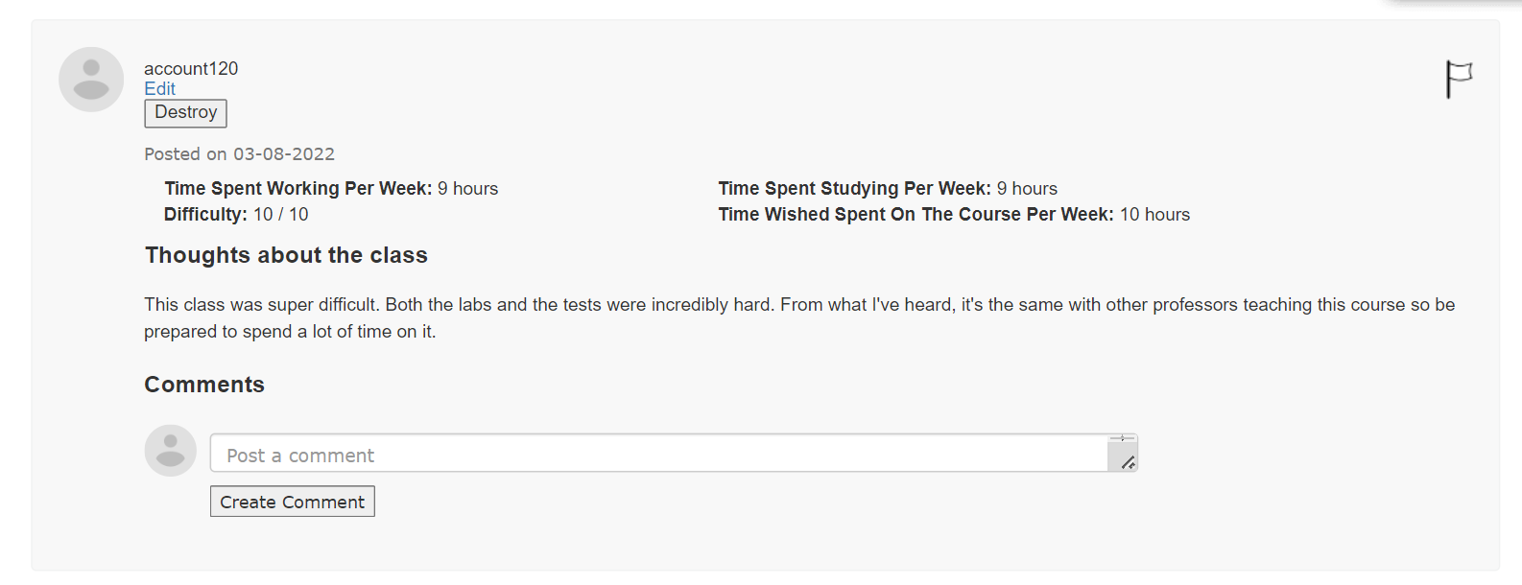
Display Review

Slide 11

Users Table

Slide 12
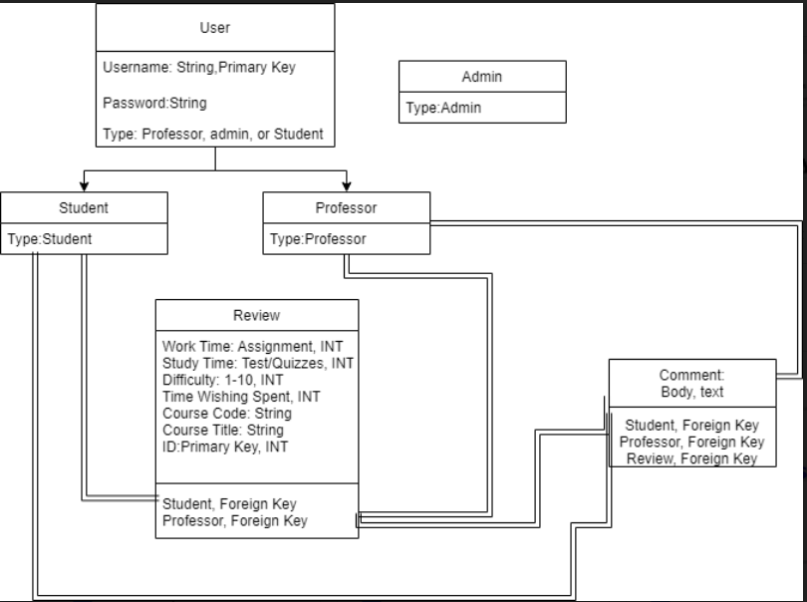
UML Database Diagram

Slide 13


Challenges and Lessons
Design may not be correct first try
Scrap old code and redo
New Language and framework to learn
Satisfying new behavior design test case may cause others to fail
Certain routing and layout may cause other tests to fail
May not run to schedule and/or complete all tasks on time
May run over budget

Slide 14
Thanks For Watching!
Team 4
Tony Yang, Jason Bernal, and Jacob Smith

